Slide 1
Futsal Field Reservation System
Developed By:
Ehtisham Naveed
CK-FA-21-110734
Saadullah
CK-FA-21-110420s
Supervised By:
Mam Nazish Bashir
Program:
Computer Science
Session:
Fall 2021 to Spring 2025
Department of Computing & Technology
Iqra University Islamabad Campus (Chak Shahzad)

Slide 2
Contents
Introduction
Problem description
Proposed Solution
Aims and Objectives
Modules and Methodology
Feasibility analysis
Prototype
Question Answer session

Slide 3
Introduction
The Futsal Field Reservation System is a web-based platform designed to assist local football teams and ground owners in managing bookings. It offers a centralized solution to simplify the reservation process and enhance communication between both parties.

Slide 4
Problem Description
Booking grounds is manual, slow, and fragmented.
Players struggle to find slots and opponents.
Ground owners face mismanagement.
Underprivileged players lack access.

Slide 5
Proposed Solution
Centralized platform for booking and management.
Academy registration and donation features.
Benefits players and ground owners.

Slide 6
Aims and Objectives
provide a centralized platform for ground booking.
Enable smooth communication between teams and facility owners.
Offer academy registration for skill development.
Create a donation feature to support underprivileged players.
Promote local football and streamline ground management.

Slide 7
Methodology
Agile Methodology: The project will use an iterative and flexible development approach to ensure continuous feedback and improvement.
Iterative Development: The project is divided into manageable cycles (sprints), each delivering a specific set of features.
Stakeholder Collaboration: Regular communication with players, ground owners, and administrators to gather feedback and refine features.
Frequent Testing: Each sprint includes testing to ensure the platform’s functionality and quality.
Faster Delivery: Prioritization of high-impact features, such as ground booking and team coordination, for early delivery.

Slide 8
Algoritham
User Registration & Authentication
Ground Listing & Search
Booking Process
Match Coordination
Payment & Donations
Notifications & Updates
Admin & Ground Owner Panel

Slide 9
Cont..
Compliance and regulation:
The project will adhere to relevant local regulations, data protection laws, and industry best practices to ensure compliance and secure operations.
Launch:
Prepare for a successful Futsal field reservation system.
Tools:
ReactJs
Html, CSS, JavaScript
Node js
SQL/MONGODB

Slide 10
Cont..
Data Collection:
It will involve conducting interviews with football players and ground owners. Additionally, focus groups will be organized to gather insights on desired functionalities, while competitor analysis will be conducted to benchmark against similar platforms for best practices.
Front-End Design:
After collecting data from football players, ground owners, and stakeholders, we will proceed to design the frontend for the Futsal Field Reservation System.
We will utilize tools like HTML, CSS, JavaScript, and ReactJS to create a dynamic and interactive interface. Additionally, Figma will be used to design wireframes and rough layouts of the platform.
The frontend will feature a user-friendly interface with consistent colors, interactive elements like buttons, booking forms, and search bars to ensure seamless navigation and ease of use for both players and ground owners.

Slide 11
Cont..
Backend:
In the backend step, we will use Node.js and Express.js to handle server-side logic and manage user requests efficiently.
MongoDB will serve as the database to store and manage unstructured data such as user profiles, bookings, and ground information.
The backend will facilitate features like user authentication, ground booking management, team coordination, and donation processing.
The system will also ensure smooth integration between the frontend and backend, with secure handling of data and real-time updates for users.

Slide 12
Feasibility Analysis
Technical Feasibility:
We have the technical skills to develop Futsal Field Reservation using HTML, CSS, java script and MySQL. Our expertise and open source tools make our project technically feasible.
Operational Feasibility:
This looks at whether the system can be used effectively within the futsal ground environment and if it can be maintained smoothly over time.
Economical Feasibility:
All the tools used in our project are open source there is no need to buy anything from somewhere. this make us our project economically feasible

Slide 13
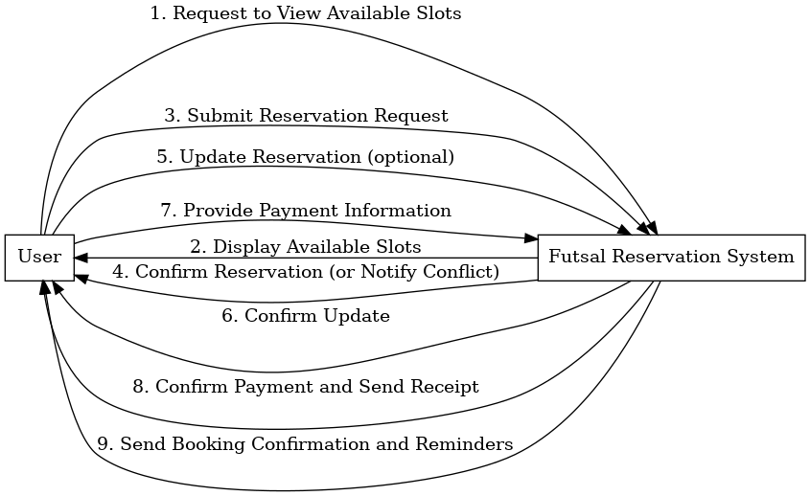
System Sequence Diagram
Diagram:

Slide 14
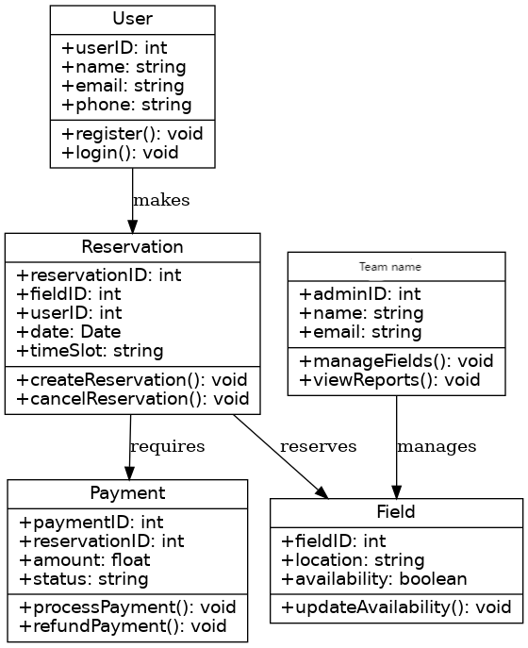
Class Diagram
Diagram:

Slide 15
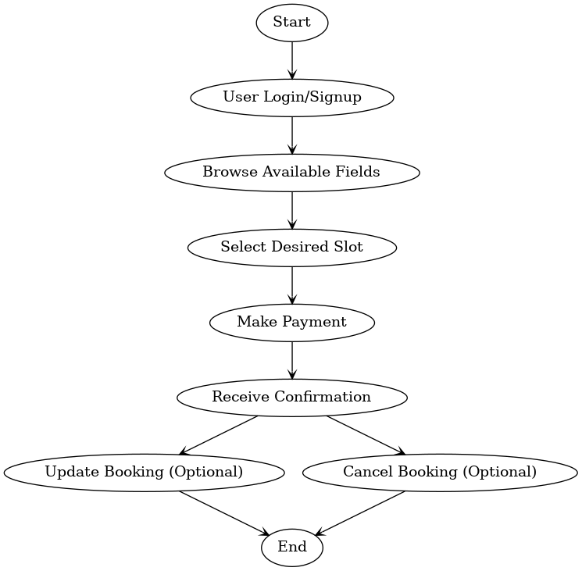
Activity Diagram
Diagram:

Slide 16
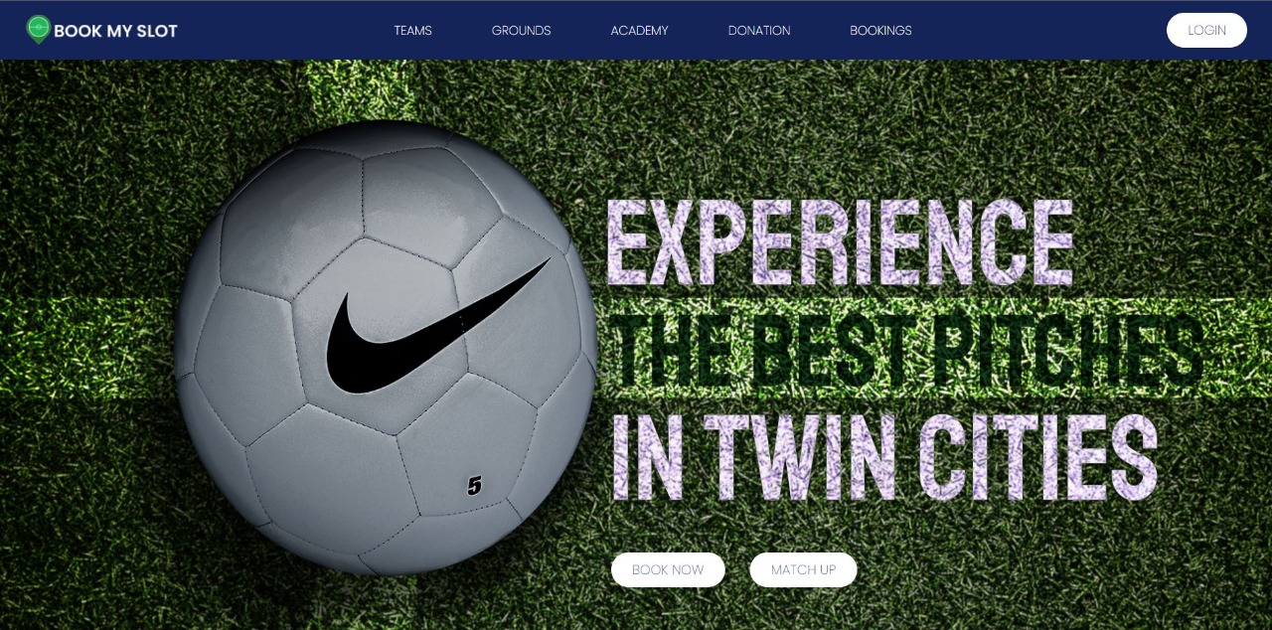
Prototype
Dashboard:

Slide 17
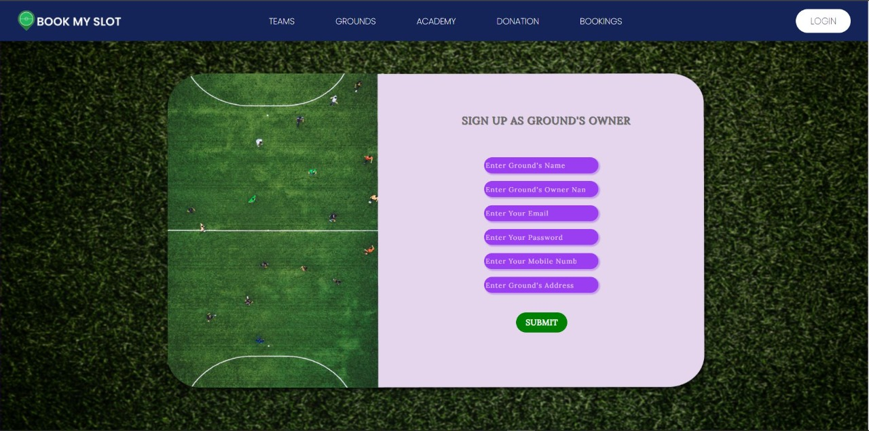
Signup for Ground Owner interface

Slide 18
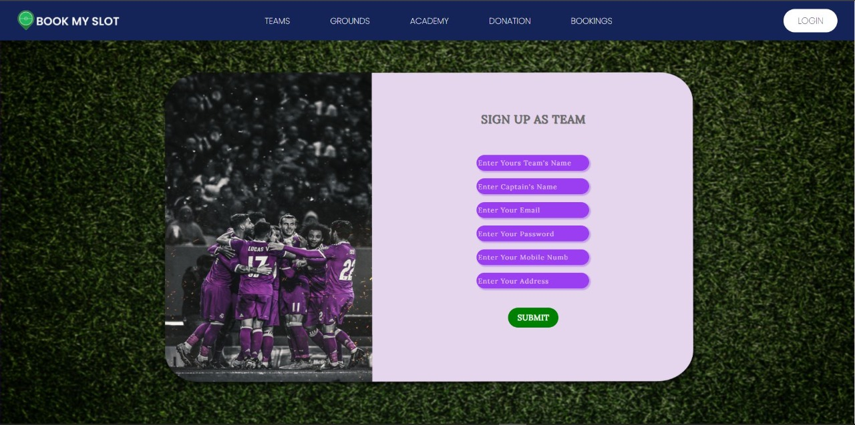
Signup for Team Owner interface

Slide 19
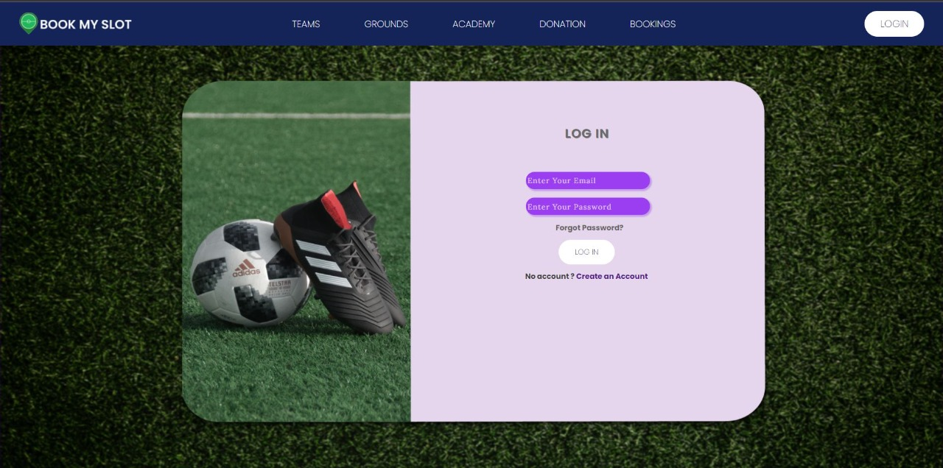
LOGIN

Slide 20
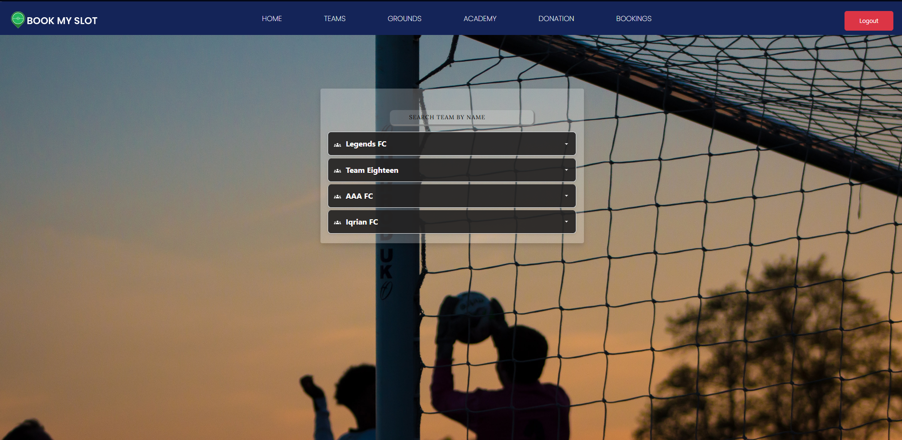
Teams Dashboard

Slide 21
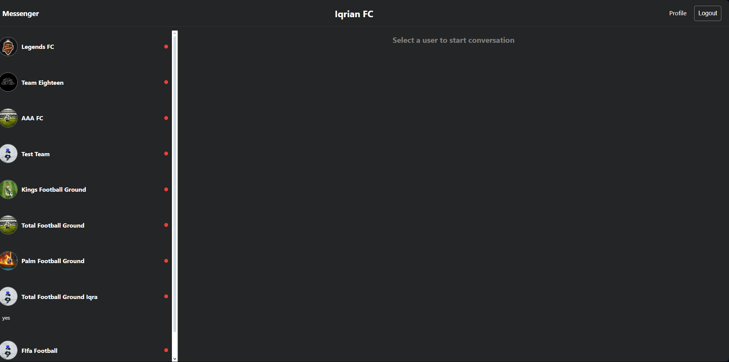
Chat bot

Slide 22
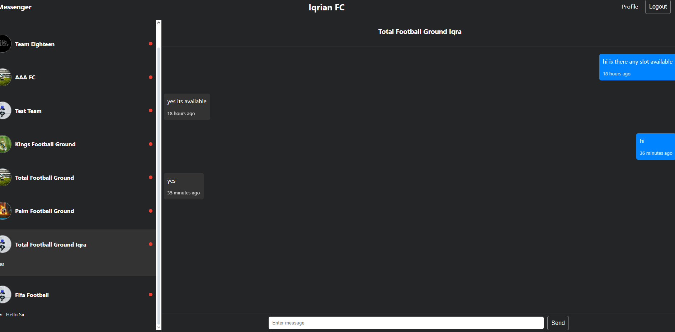
Testing Chat bot between Ground and team

Slide 23
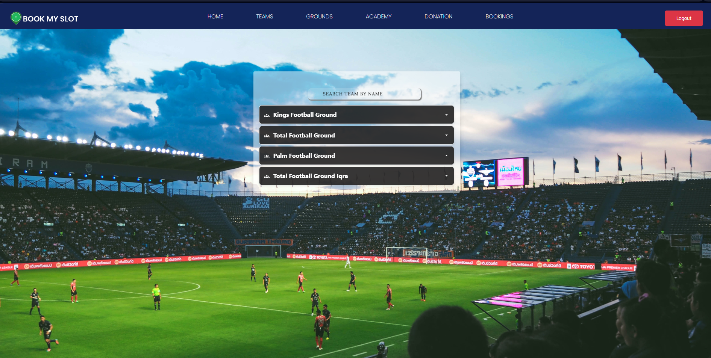
Ground Dashboard

Slide 24
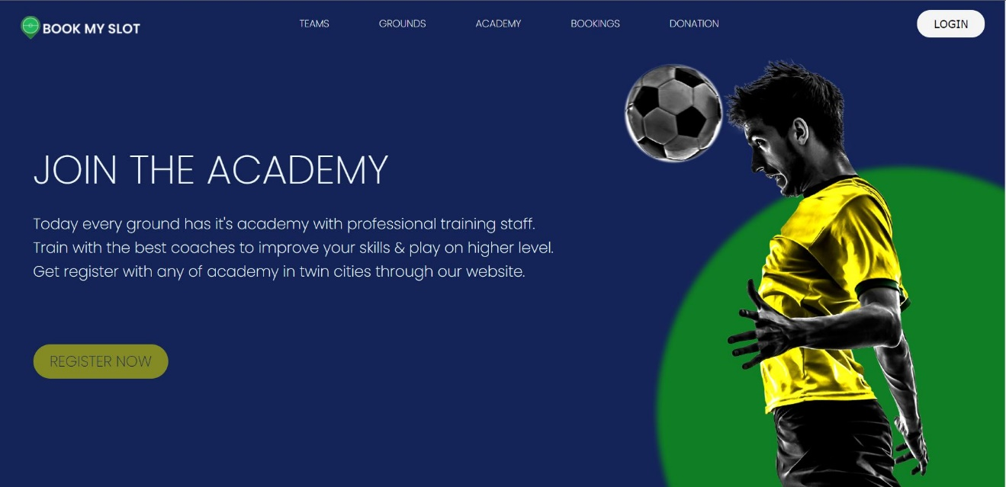
Academy Dashboard

Slide 25
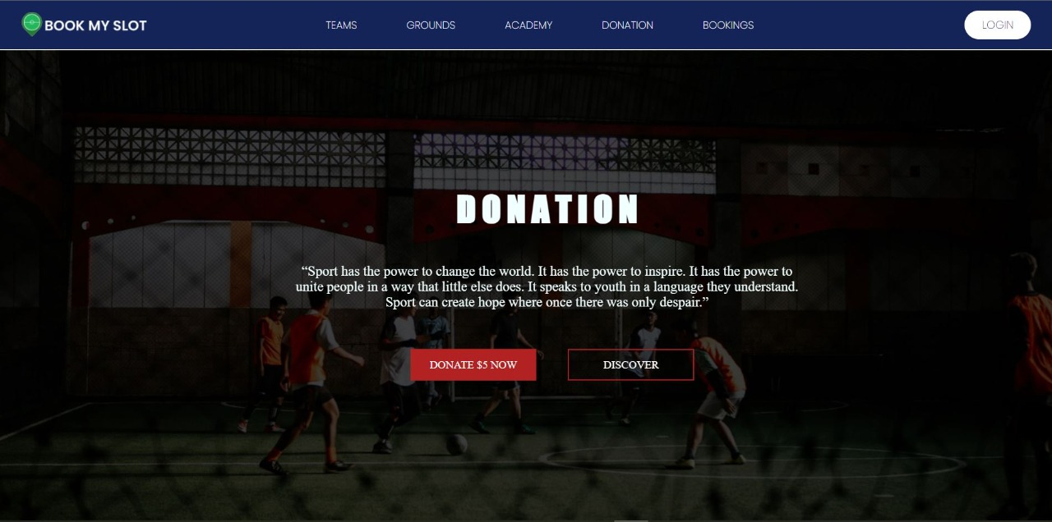
Donation Dashboard

Slide 26
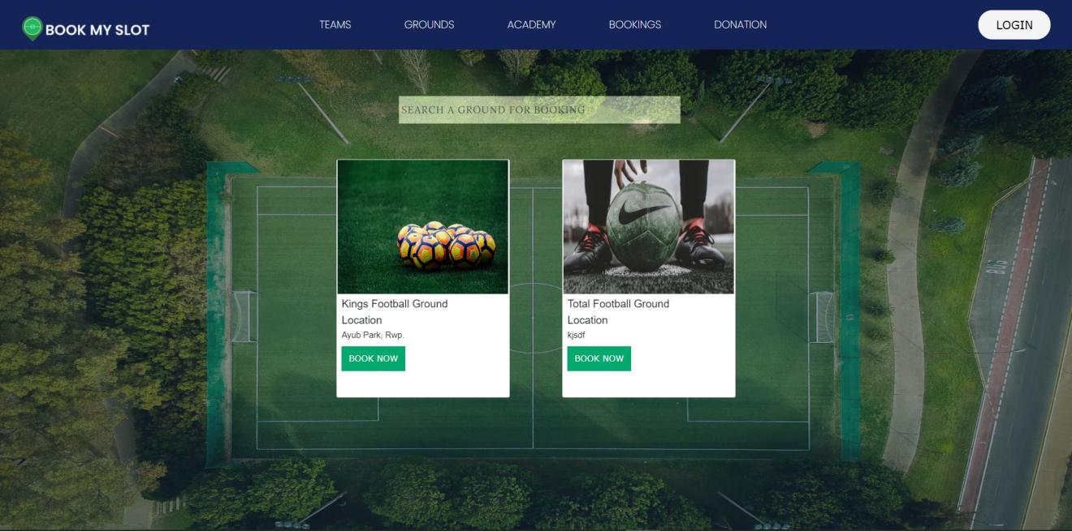
Bookings

Slide 27
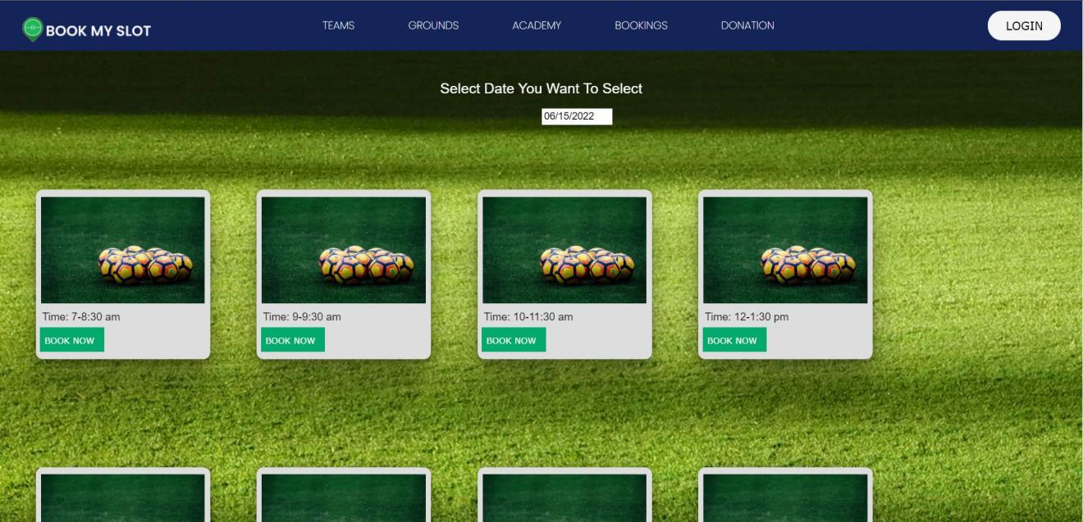
Slots Timing / Available Slots

Slide 28
Any Questions?

Slide 29
THANK YOU

